Slide 1
Website Navigation Behavior Analysis for Bot Detection
By Rabih Haidar, Shady Elbassuoni
Reviewed By
Name: Md Fuad Islam, Id: 20101060, Section:01
Course code: CSE438

Slide 2
Problem Statement:
To effectively detect malicious bots that crawls over websites on the internet using machine learning approach

Slide 3
Current ways to handle the situation:
Use of captcha
Use of ip address/domain database of malicious bots.

Slide 4
Cons:
Bots can change their ip addresses frequently.
The database needs to be maintained frequently.
Filling captcha can easily become a burden and people do not prefer doing so repeatedly.

Slide 5
Approach:
To make a classifier using machine learning algorithms to detect bots and human apart for specific websites .

Slide 6
Pros:
As the classifier is trained for specific website, bots cannot imitate same behaviour.
Can be easily integrated with current methods for recognizing bots.

Slide 7
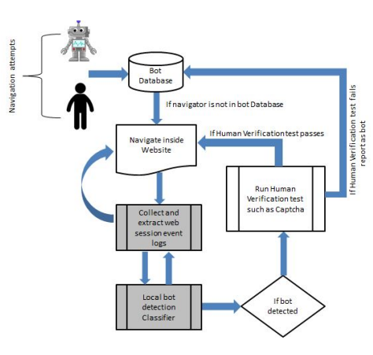
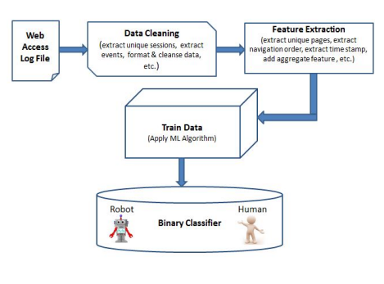

Slide 8
Implementation:
Used on two websites, namely “wheeler” and “wherelab”
Accuracy: 83%
Accuracy compared against competitor model is better by 14%

Slide 9
Related work:
Check mouse movement, keyboard typing using java scripts. However, most people disable java scripts.
Use invisible sections, distinguish specific features. However, this can also be easily bypassed
Bayesian approach was also proposed for detecting bots based on the similarity of their DNS traffic to that of known bots

Slide 10
Collecting data:
Used website logs consisting of session id, the client IP address and domain, the navigated pages, the navigation timestamps and other navigation information such as multimedia hit events.

Slide 11
Data Cleansing:
Use binary classifier to differentiate bots and human. (0 - for human, 1 - for bots )
Use of existing bot’s ip addresses/domain database to classify bots.
Use of special tools by the admins to accurately detect bots and humans.

Slide 12
Feature Extraction:
Features are mainly extracted into four subsets, which are:
pages hit or not by binary classification.
navigation order.
number of time page had been hit.
time spent on a page

Slide 13
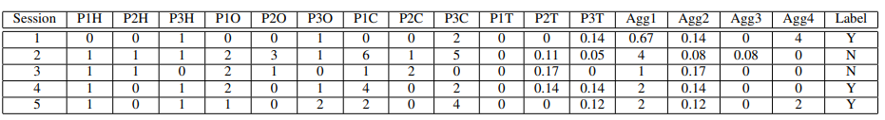

Slide 14
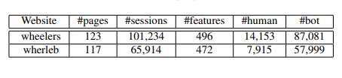
Dataset:

Slide 15
Model selection and training:
First to select model, 10 fold cross validation was used.
Dataset was divided according to standard where 60% was used for training and 40% was used for testing.
Model was trained.

Slide 16
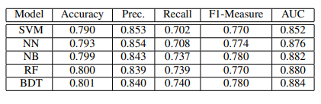
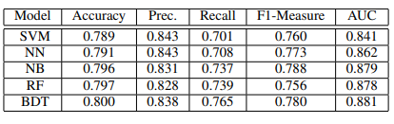


Slide 17
End remarks:
Under-sampling was used to remove data imbalance.
Results says that there are many bots that navigates website slowly in order to imitate humans, hence not using the time features yield better results.
To be able to use good, useful bots (search engine bots) in website, instead of binary classification, a three way classifier was also implemented.

Slide 18
Conclusion:
Humans navigate different website in different ways, bots cannot mimic that.
For further work, this approach can be implemented in larger websites.

